Slide 1
to our class

Slide 2
Unit 5: study habits
Listen and read

Slide 3
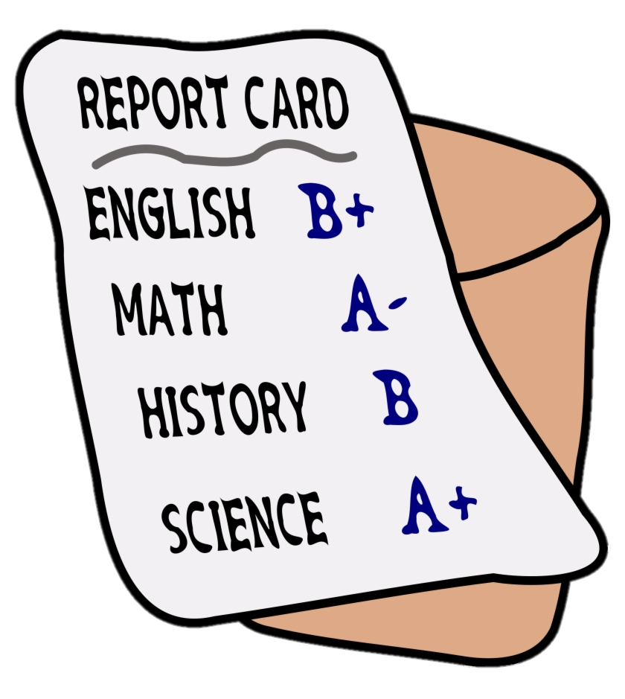
vocabulary
report card
phiếu điểm

Slide 4
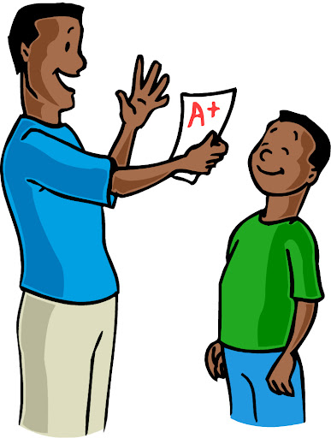
vocabulary
proud (of)
(adj) tự hào

Slide 5
vocabulary
improve
(v) cải thiện, tiến bộ

Slide 6
vocabulary
pronounce
(v) phát âm
pronounciation
(n) cách phát âm

Slide 7
vocabulary
report card (n) phiếu điểm
proud (of) (adj) tự hào
improve (v) cải thiện, tiến bộ
pronounce (v) phát âm
pronunciation (n) sự phát âm

Slide 8
LISTEN AND READ
Mom: | Tim? Tim? Are you home?
Tim: | Yes, Mom. I’m in the living-room. What is it, Mom?
Mom: | I went to your school today and Miss Jackson gave me your report card.
Tim: | Oh, is it a good report?
Mom: | Don’t worry. It’s excellent. You did very well.
Tim: | May I see the report?
Mom: | Sure. I’m proud of you, Tim. I know you worked really hard this semester.
Tim: | Thanks, Mom.
Mom: | But there’s one thing you need to improve.
Tim: | What’s that, Mom?
Mom: | Miss Jackson said you should work harder on your Spanish pronunciation. She asked me to give you this dictionary.
Tim: | Yes, I know. Some of those Spanish sounds are really hard. I’ll try my best to improve them
Mom: | I believe you can do it, Tim.

Slide 9
TRUE OR FALSE ?
a) Tim was out when his mother called him.
FALSE
Mom: | Tim? Tim? Are you home?
Tim: | Yes, Mom. I’m in the living-room. What is it, Mom?
Mom: | I went to your school today and Miss Jackson gave me your report card.
Tim: | Oh, is it a good report?
Mom: | Don’t worry. It’s excellent. You did very well.
Tim: | May I see the report?
Mom: | Sure. I’m proud of you, Tim. I know you worked really hard this semester.
Tim: | Thanks, Mom.
Mom: | But there’s one thing you need to improve.
Tim: | What’s that, Mom?
Mom: | Miss Jackson said you should work harder on your Spanish pronunciation. She asked me to give you this dictionary.
Tim: | Yes, I know. Some of those Spanish sounds are really hard. I’ll try my best to improve them.
Mom: | I believe you can do it, Tim.

Slide 10
TRUE OR FALSE ?
b) Tim’s mother met his teacher at school.
TRUE
Mom: | Tim? Tim? Are you home?
Tim: | Yes, Mom. I’m in the living-room. What is it, Mom?
Mom: | I went to your school today and Miss Jackson gave me your report card.
Tim: | Oh, is it a good report?
Mom: | Don’t worry. It’s excellent. You did very well.
Tim: | May I see the report?
Mom: | Sure. I’m proud of you, Tim. I know you worked really hard this semester.
Tim: | Thanks, Mom.
Mom: | But there’s one thing you need to improve.
Tim: | What’s that, Mom?
Mom: | Miss Jackson said you should work harder on your Spanish pronunciation. She asked me to give you this dictionary.
Tim: | Yes, I know. Some of those Spanish sounds are really hard. I’ll try my best to improve them.
Mom: | I believe you can do it, Tim.

Slide 11
TRUE OR FALSE ?
c) Tim’s report is poor.
FALSE
Mom: | Tim? Tim? Are you home?
Tim: | Yes, Mom. I’m in the living-room. What is it, Mom?
Mom: | I went to your school today and Miss Jackson gave me your report card.
Tim: | Oh, is it a good report?
Mom: | Don’t worry. It’s excellent. You did very well.
Tim: | May I see the report?
Mom: | Sure. I’m proud of you, Tim. I know you worked really hard this semester.
Tim: | Thanks, Mom.
Mom: | But there’s one thing you need to improve.
Tim: | What’s that, Mom?
Mom: | Miss Jackson said you should work harder on your Spanish pronunciation. She asked me to give you this dictionary.
Tim: | Yes, I know. Some of those Spanish sounds are really hard. I’ll try my best to improve them.
Mom: | I believe you can do it, Tim.

Slide 12
TRUE OR FALSE ?
d) Tim’s mother wants him to improve one thing.
TRUE
Mom: | Tim? Tim? Are you home?
Tim: | Yes, Mom. I’m in the living-room. What is it, Mom?
Mom: | I went to your school today and Miss Jackson gave me your report card.
Tim: | Oh, is it a good report?
Mom: | Don’t worry. It’s excellent. You did very well.
Tim: | May I see the report?
Mom: | Sure. I’m proud of you, Tim. I know you worked really hard this semester.
Tim: | Thanks, Mom.
Mom: | But there’s one thing you need to improve.
Tim: | What’s that, Mom?
Mom: | Miss Jackson said you should work harder on your Spanish pronunciation. She asked me to give you this dictionary.
Tim: | Yes, I know. Some of those Spanish sounds are really hard. I’ll try my best to improve them.
Mom: | I believe you can do it, Tim.

Slide 13
TRUE OR FALSE ?
e) Tim needs to improve his Spanish grammar.
FALSE
Mom: | Tim? Tim? Are you home?
Tim: | Yes, Mom. I’m in the living-room. What is it, Mom?
Mom: | I went to your school today and Miss Jackson gave me your report card.
Tim: | Oh, is it a good report?
Mom: | Don’t worry. It’s excellent. You did very well.
Tim: | May I see the report?
Mom: | Sure. I’m proud of you, Tim. I know you worked really hard this semester.
Tim: | Thanks, Mom.
Mom: | But there’s one thing you need to improve.
Tim: | What’s that, Mom?
Mom: | Miss Jackson said you should work harder on your Spanish pronunciation. She asked me to give you this dictionary.
Tim: | Yes, I know. Some of those Spanish sounds are really hard. I’ll try my best to improve them.
Mom: | I believe you can do it, Tim.

Slide 14
TRUE OR FALSE ?
f) Tim promised to try his best in learning Spanish.
TRUE
Mom: | Tim? Tim? Are you home?
Tim: | Yes, Mom. I’m in the living-room. What is it, Mom?
Mom: | I went to your school today and Miss Jackson gave me your report card.
Tim: | Oh, is it a good report?
Mom: | Don’t worry. It’s excellent. You did very well.
Tim: | May I see the report?
Mom: | Sure. I’m proud of you, Tim. I know you worked really hard this semester.
Tim: | Thanks, Mom.
Mom: | But there’s one thing you need to improve.
Tim: | What’s that, Mom?
Mom: | Miss Jackson said you should work harder on your Spanish pronunciation. She asked me to give you this dictionary.
Tim: | Yes, I know. Some of those Spanish sounds are really hard. I’ll try my best to improve them.
Mom: | I believe you can do it, Tim.

Slide 15
Answer the questions
a) Who is Miss Jackson?
She is Tim’s teacher.
b) What did Miss Jackson give Tim’s mother?
She gave Tim’s mother his report card.

Slide 16
Answer the questions
c) How did Tim study this semester?
He studied very hard.
d) What did Miss Jackson say Tim should do?
She said that Tim should work harder on his Spanish pronounciation

Slide 17
Answer the questions
c) How did Tim study this semester?
He studied very hard.
d) What did Miss Jackson say Tim should do?
She said that Tim should work harder on his Spanish pronounciation

Slide 18
Answer the questions
e) What did Tim’s mother give him at the end of the conversation?
She gave him a dictionary.

